Slide 1



Telangana Tourism Report
View in Power BI
By Abhijeet Sethy

Slide 2
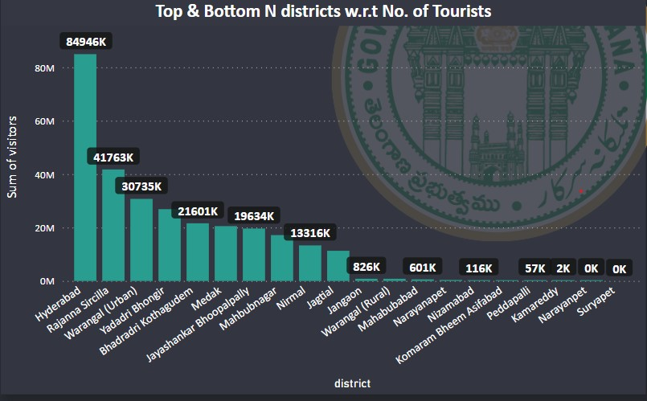
List down the top 10 districts those have the highest number of Domestic visitors overall (2016-2019)?
Here, we can see that Hyderabad,
Ranjanna Sircilla, Warangal(Urban) are
Top 3 Highest tourist spots, and
Kamareddy, Narayanpet and Suryapet are
Bottom 3 districts.
SUGGESTIONS
Identifying and promote unique local attractions, landmarks, or cultural events that set the district apart.
Foster collaboration with local businesses to create packages or special offers that encourage visitors to explore the district. This might include partnerships with restaurants, hotels, and shops.
Establish and enhance the district's digital presence. Develop a user-friendly website, leverage social media, and use online marketing to reach a broader audience.

Slide 3
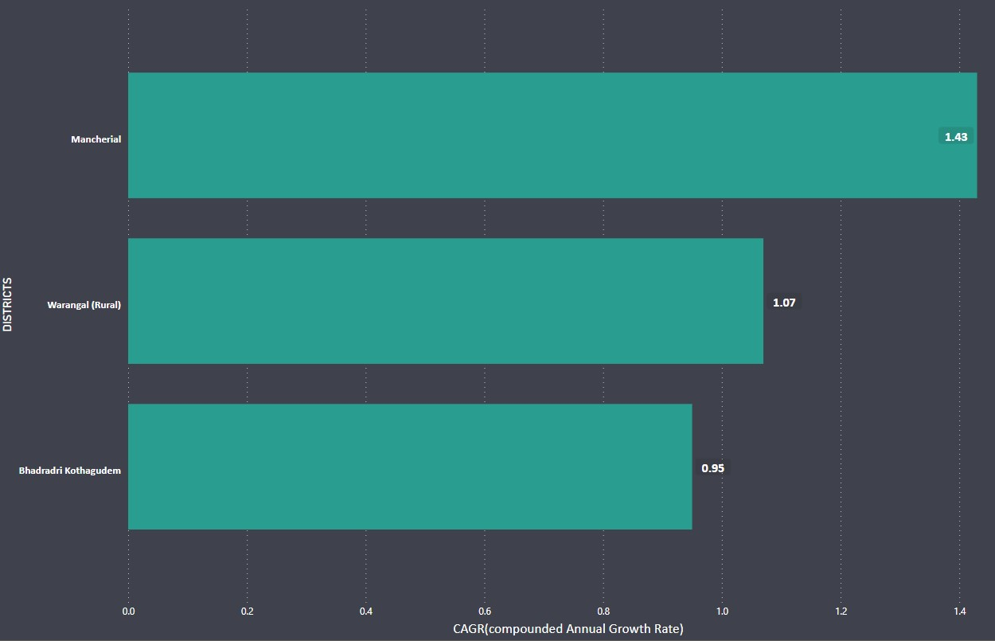
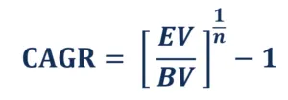
List down the top 3 districts based on compounded annual growth rate (CAGR) of visitors between (2016-2019)?
CAGR(Compounded Annual Growth) typically stands for Compound Annual Growth Rate, and it is a measure of the geometric progression ratio that provides a constant rate of growth over a time period.
EV: Early Value
BV: Beginning Value
n : Number of compounded
years
Mancherial, Warangal(Rural) and Bhadraderi Kothagudem are Top 3 districts having high CAGR value.

Slide 4
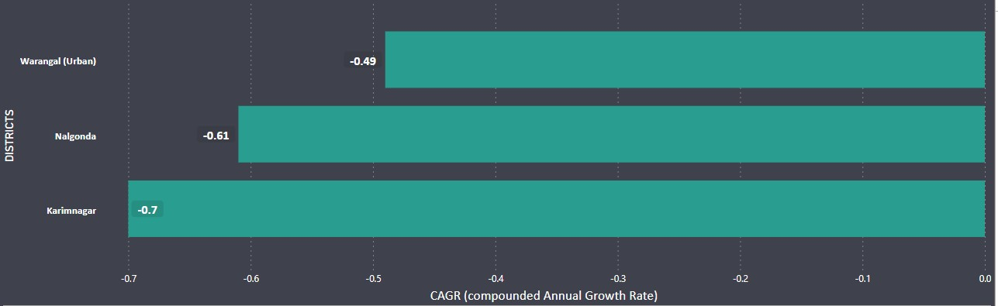
List down the bottom 3 districts based on compounded annual growth rate (CAGR) of visitors between (2016-2019)?
Warangal (Urban), Nalgonda, and Karimnagar are the bottom three districts with the lowest CAGR values, indicating a reduction in tourist growth.
SUGGESTIONS
Invest in targeted marketing campaigns to promote the region's attractions. Utilize digital marketing, social media, and traditional advertising to reach a wider audience.
Improve and invest in infrastructure such as transportation, roads, and accommodation facilities. Easy accessibility and comfortable stays can positively impact tourism.
Collect feedback from tourists and use it to make continuous improvements. Understand what visitors like and dislike to enhance the overall experience.

Slide 5
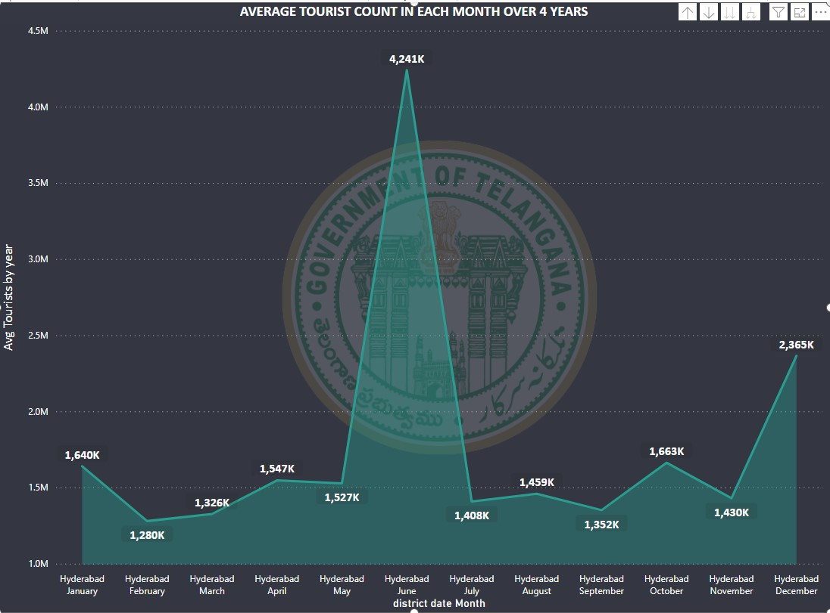
What are the Peak and Low season months for Hyderabad based on the data from 2016-2019 ?
From the area chart we can conclude that for Hyderabad the Top 3 peak seasons are June, December and October .
The low season months are February, March and September.
SUGGESTIONS
In order to have a well distributed tourist count through out a year Govt. need to plan well for the peak seasons and for low seasons Govt. can introduce cultural events and unique activities which will attract more tourists.
Use social media to launch targeted campaigns that showcase the unique aspects of the destination during the low season.

Slide 6
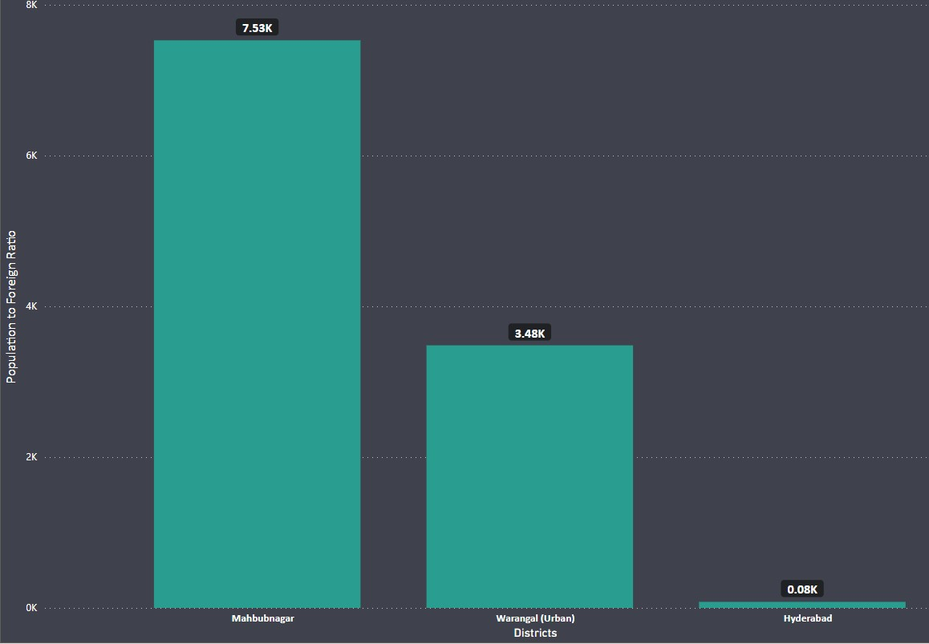
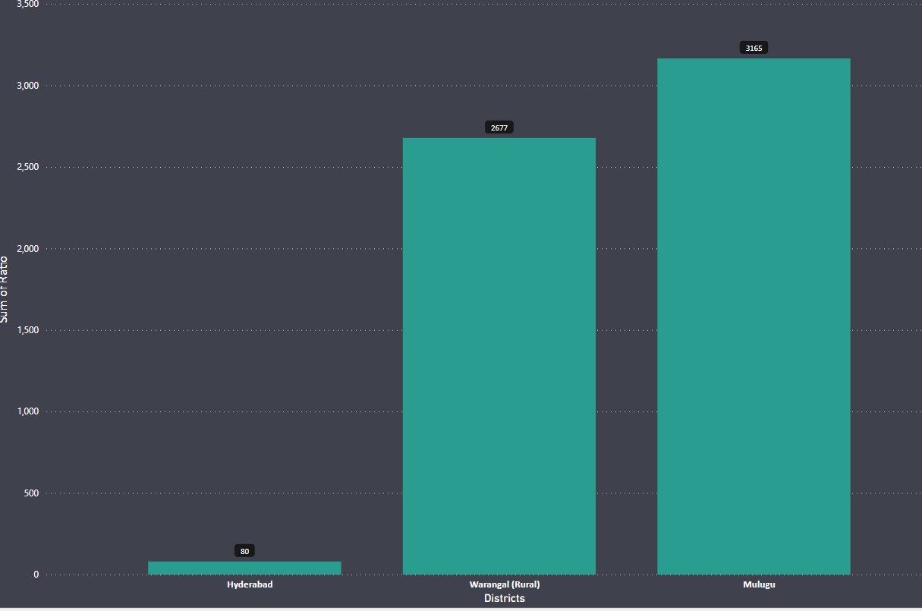
Show the top and bottom 3 districts with high domestic to foreign tourist ratio?
A high domestic-to-foreign ratio suggests that a destination is more popular among local residents, while a lower ratio indicates a higher proportion of international visitors.
From the above chart, we can see that more local tourists are coming to Mahbubnagar and Warangal (Urban), whereas foreign tourists are visiting Hyderabad and Warangal (Rural) districts more.

Slide 7
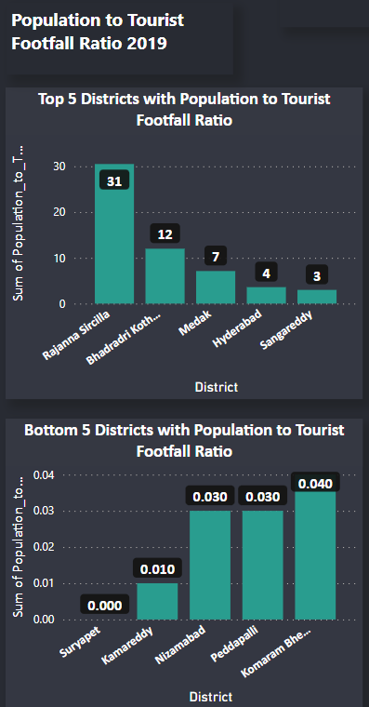
List the top and bottom 5 district based on ‘population to tourist footfall ratio in 2019?
This ratio is useful for policymakers, urban planners, and businesses to understand the impact of tourism on a community.
A high ratio may indicate a significant reliance on tourism for the local economy, but it could also pose challenges such as increased congestion, strain on infrastructure, and potential impacts on local culture and environment.
On the other hand, a low ratio might suggest that tourism is not a major economic driver, and there could be potential for growth in the tourism sector.
Rajanna Sircilla has the highest Tourist to Population footfall ratio, indicating a considerable reliance on tourism for Rajanna Sircilla's local economy.
The lowest tourist to population footfall ratio in Komaram Bheem Asifabad indicates that tourism is not a key economic driver here.

Slide 8
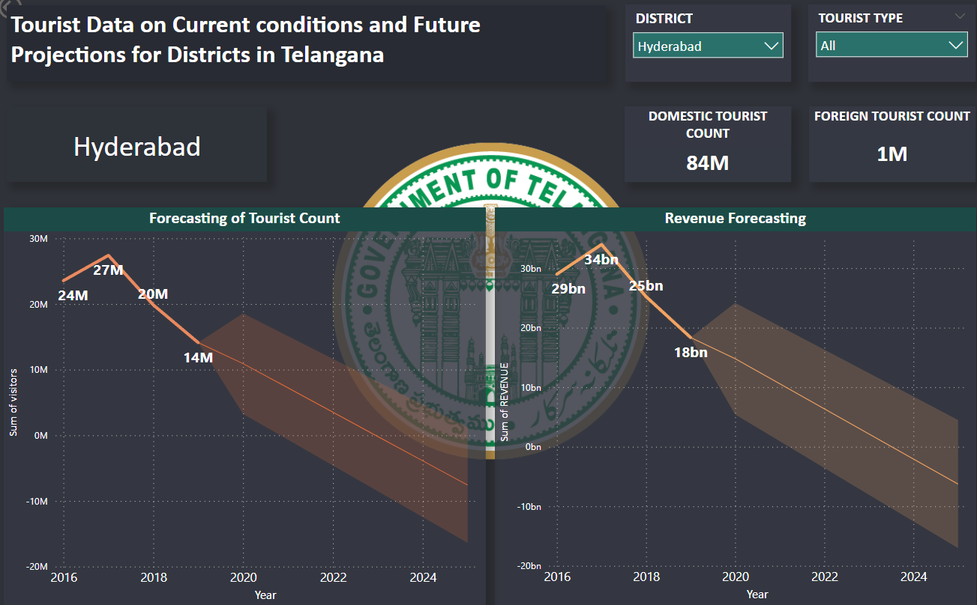
What will be the projected number of domestic and foreign tourists in Hyderabad in 2025 based on the growth rate from previous years?
The projected number of Domestic and Foreign tourists in Hyderabad 2025 is shown in this chart.
We can see that the curve is going down for both tourist count and Revenue.
The forecasting is done using a confidence interval of 95%.
(The confidence level is a percentage that reflects the probability that the true value falls within the calculated confidence interval.)

Slide 9
Thank You…

